Slide 1



Defining Classes
Classes, Fields, Constructors, Methods, Properties
Svetlin Nakov
Telerik Corporation
www.telerik.com

Slide 2

Table of Contents
Defining Simple Classes
Access Modifiers
Using Classes and Objects
Constructors
Properties
Static Members

Slide 3
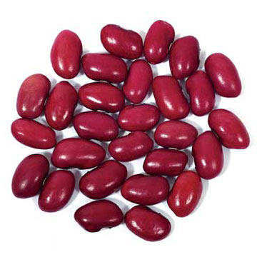
Defining Simple Classes

Slide 4
Classes in OOP
Classes model real-world objects and define
Attributes (state, properties, fields)
Behavior (methods, operations)
Classes describe structure of objects
Objects describe particular instance of a class
Properties hold information about the modeled object relevant to the problem
Operations implement object behavior

Slide 5
Classes in C#
Classes in C# could have following members:
Fields, constants, methods, properties, indexers, events, operators, constructors, destructors
Inner types (inner classes, structures, interfaces, delegates, ...)
Members can have access modifiers (scope)
public, private, protected, internal
Members can be
static (common) or specific for a given object

Slide 6
Simple Class Definition
Begin of class definition
public class Cat : Animal {
private string name;
private string owner;
public Cat(string name, string owner)
{
this.name = name;
this.owner = owner;
}
public string Name
{
get { return name; }
set { name = value; }
}
Inherited (base) class
Fields
Constructor
Property

Slide 7

Simple Class Definition (2)
public string Owner
{
get { return owner;}
set { owner = value; }
}
public void SayMiau()
{
Console.WriteLine("Miauuuuuuu!");
}
}
Method
End of class definition

Slide 8

Class Definition and Members
Class definition consists of:
Class declaration
Inherited class or implemented interfaces
Fields (static or not)
Constructors (static or not)
Properties (static or not)
Methods (static or not)
Events, inner types, etc.

Slide 9
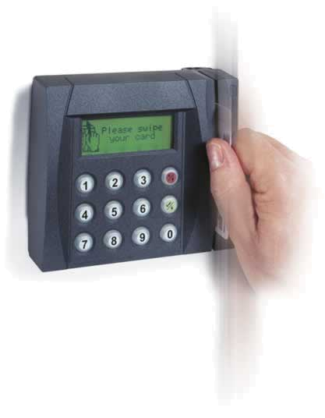

Access Modifiers
Public, Private, Protected, Internal

Slide 10
Access Modifiers
Class members can have access modifiers
Used to restrict the classes able to access them
Supports the OOP principle "encapsulation"
Class members can be:
public – accessible from any class
protected – accessible from the class itself and all its descendent classes
private – accessible from the class itself only
internal – accessible from the current assembly (used by default)

Slide 11

Defining Simple Classes
Example

Slide 12
Task: Define Class Dog
Our task is to define a simple class that represents information about a dog
The dog should have name and breed
If there is no name or breed assigned to the dog, it should be named "Balkan" and its breed should be "Street excellent"
It should be able to view and change the name and the breed of the dog
The dog should be able to bark
Notes:
Mew = мяукам!

Slide 13

Defining Class Dog – Example
public class Dog {
private string name;
private string breed;
public Dog()
{
this.name = "Balkan";
this.breed = "Street excellent";
}
public Dog(string name, string breed)
{
this.name = name;
this.breed = breed;
}
(example continues)

Slide 14

Defining Class Dog – Example (2)
public string Name
{
get { return name; }
set { name = value; }
}
public string Breed
{
get { return breed; }
set { breed = value; }
}
public void SayBau()
{
Console.WriteLine("{0} said: Bauuuuuu!", name);
}
}

Slide 15

Defining Class Dog
Live Demo

Slide 16

Using Classes and Objects

Slide 17

Using Classes
How to use classes?
Create a new instance
Access the properties of the class
Invoke methods
Handle events
How to define classes?
Create new class and define its members
Create new class using some other as base class

Slide 18

How to Use Classes (Non-static)?
Create an instance
Initialize fields
Manipulate instance
Read / change properties
Invoke methods
Handle events
Release occupied resources
Done automatically in most cases

Slide 19
Task: Dog Meeting
Our task is as follows:
Create 3 dogs
First should be named “Sharo”, second – “Rex” and the last – left without name
Add all dogs in an array
Iterate through the array elements and ask each dog to bark
Note:
Use the Dog class from the previous example!

Slide 20
Dog Meeting – Example
static void Main()
{
Console.WriteLine("Enter first dog's name: ");
dogName = Console.ReadLine();
Console.WriteLine("Enter first dog's breed: ");
dogBreed = Console.ReadLine();
// Using the Dog constructor to set name and breed
Dog firstDog = new Dog(dogName, dogBreed);
Dog secondDog = new Dog();
Console.WriteLine("Enter second dog's name: ");
dogName = Console.ReadLine();
Console.WriteLine("Enter second dog's breed: ");
dogBreed = Console.ReadLine();
// Using properties to set name and breed
secondDog.Name = dogName;
secondDog.Breed = dogBreed;
}

Slide 21

Dog Meeting
Live Demo

Slide 22
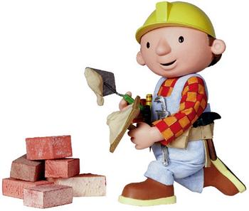
Constructors
Defining and Using Class Constructors

Slide 23
What is Constructor?
Constructors are special methods
Invoked when creating a new instance of an object
Used to initialize the fields of the instance
Constructors has the same name as the class
Have no return type
Can have parameters
Can be private, protected, internal, public

Slide 24

Defining Constructors
Class Point with parameterless constructor:
public class Point
{
private int xCoord;
private int yCoord;
// Simple default constructor
public Point()
{
xCoord = 0;
yCoord = 0;
}
// More code ...
}

Slide 25
Defining Constructors (2)
public class Person
{
private string name;
private int age;
// Default constructor
public Person()
{
name = "[no name]";
age = 0;
}
// Constructor with parameters
public Person(string name, int age)
{
this.name = name;
this.age = age;
}
// More code ...
}
As rule constructors should initialize all own class fields.

Slide 26
Constructors and Initialization
Pay attention when using inline initialization!
public class ClockAlarm
{
private int hours = 9; // Inline initialization
private int minutes = 0; // Inline initialization
// Default constructor
public ClockAlarm()
{ }
// Constructor with parameters
public ClockAlarm(int hours, int minutes)
{
this.hours = hours; // Invoked after the inline
this.minutes = minutes; // initialization!
}
// More code ...
}

Slide 27

Chaining Constructors Calls
Reusing constructors
public class Point
{
private int xCoord;
private int yCoord;
public Point() : this(0,0) // Reuse constructor
{
}
public Point(int xCoord, int yCoord)
{
this.xCoord = xCoord;
this.yCoord = yCoord;
}
// More code ...
}

Slide 28

Constructors
Live Demo

Slide 29
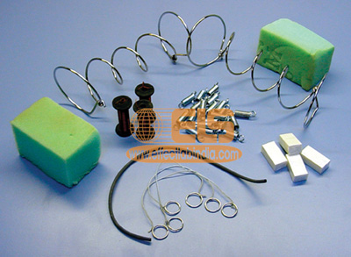
Properties
Defining and Using Properties

Slide 30
The Role of Properties
Expose object's data to the outside world
Control how the data is manipulated
Properties can be:
Read-only
Write-only
Read and write
Give good level of abstraction
Make writing code easier

Slide 31
Defining Properties
Properties should have:
Access modifier (public, protected, etc.)
Return type
Unique name
Get and / or Set part
Can contain code processing data in specific way

Slide 32
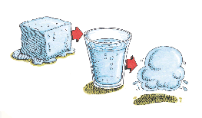
Defining Properties – Example
public class Point
{
private int xCoord;
private int yCoord;
public int XCoord
{
get { return xCoord; }
set { xCoord = value; }
}
public int YCoord
{
get { return yCoord; }
set { yCoord = value; }
}
// More code ...
}

Slide 33
Dynamic Properties
Properties are not obligatory bound to a class field – can be calculated dynamically
public class Rectangle
{
private float width;
private float height;
// More code ...
public float Area
{
get
{
return width * height;
}
}
}

Slide 34
Automatic Properties
Properties could be defined without an underlying field behind them
It is automatically created by the compiler
class UserProfile
{
public int UserId { get; set; }
public string FirstName { get; set; }
public string LastName { get; set; }
}
…
UserProfile profile = new UserProfile() {
FirstName = "Steve",
LastName = "Balmer",
UserId = 91112 };

Slide 35
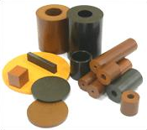
Properties
Live Demo

Slide 36

Static Members
Static vs. Instance Members

Slide 37

Static Members
Static members are associated with a type rather than with an instance
Defined with the modifier static
Static can be used for
Fields
Properties
Methods
Events
Constructors

Slide 38
Static vs. Non-Static
Static:
Associated with a type, not with an instance
Non-Static:
The opposite, associated with an instance
Static:
Initialized just before the type is used for the first time
Non-Static:
Initialized when the constructor is called

Slide 39

Static Members – Example
public class SqrtPrecalculated
{
public const int MAX_VALUE = 10000;
// Static field
private static int[] sqrtValues;
// Static constructor
private static SqrtPrecalculated()
{
sqrtValues = new int[MAX_VALUE + 1];
for (int i = 0; i < sqrtValues.Length; i++)
{
sqrtValues[i] = (int)Math.Sqrt(i);
}
}
(example continues)

Slide 40

Static Members – Example (2)
// Static method
public static int GetSqrt(int value)
{
return sqrtValues[value];
}
// The Main() method is always static
static void Main()
{
Console.WriteLine(GetSqrt(254));
}
}

Slide 41

Static Members
Live Demo

Slide 42

Generic Classes
Parameterized Classes and Methods

Slide 43
What are Generics?
Generics allow defining parameterized classes that process data of unknown (generic) type
The class can be instantiated with several different particular types
Example: List<T> → List<int> / List<string> / List<Student>
Generics are also known as "parameterized types" or "template types"
Similar to the templates in C++
Similar to the generics in Java

Slide 44
Generics – Example
T is an unknown type, parameter of the class
public class GenericList<T>
{
public void Add(T element) { … }
}
class GenericListExample
{
static void Main()
{
// Declare a list of type int
GenericList<int> intList =
new GenericList<int>();
// Declare a list of type string
GenericList<string> stringList =
new GenericList<string>();
}
}
T can be used in any method in the class

Slide 45

Generic Classes
Live Demo

Slide 46
Summary
Classes define specific structure for objects
Objects are particular instances of a class and use this structure
Constructors are invoked when creating new class instances
Properties expose the class data in safe, controlled way
Static members are shared between all instances
Instance members are per object

Slide 47

Defining Classes and Objects
Questions?

Slide 48
Exercises
Define a class that holds information about a mobile phone device: model, manufacturer, price, owner, battery characteristics (model, hours idle and hours talk) and display characteristics (size and colors). Define 3 separate classes: GSM, Battery and Display.
Define several constructors for the defined classes that take different sets of arguments (the full information for the class or part of it). The unknown data fill with null.
Add a static field NokiaN95 in the GSM class to hold the information about Nokia N95 device.

Slide 49
Exercises (2)
Add a method in the class GSM for displaying all information about it.
Use properties to encapsulate data fields inside the GSM, Battery and Display classes.
Write a class GSMTest to test the functionality of the GSM class:
Create several instances of the class and store them in an array.
Display the information about the created GSM instances.
Display the information about the static member NokiaN95.

Slide 50
Exercises (3)
Create a class Call to hold a call performed through a GSM. It should contain date, time and duration.
Add a property CallsHistory in the GSM class to hold a list of the performed calls. Use array.
Add methods in the GSM class for adding and deleting calls to the calls history. Add a method to clear the call history.
Add a method that calculates the total price of the calls in the call history. Assume the price per minute is given as parameter.

Slide 51
Exercises (4)
Write a class GSMCallHistoryTest to test the call history functionality of the GSM class.
Create an instance of the GSM class.
Add few calls.
Display the information about the calls.
Assuming that the price per minute is 0.37 calculate and print the total price of the calls.
Remove the longest call from the history and calculate the total price again.
Finally clear the call history and print it.

Slide 52
Exercises (5)
Write generic class GenericList<T> that keeps a list of elements of some parametric type T. Keep the elements of the list in an array with fixed capacity which is given as parameter in the class constructor. Implement methods for adding element, accessing element by index, removing element by index, inserting element at given position, clearing the list, finding element by its value and ToString(). Check all input parameters to avoid accessing elements at invalid positions.
Implement auto-grow functionality: when the internal array is full, create a new array of double size and move all elements to it.

Slide 53
Exercises (6)
Define class Fraction that holds information about fractions: numerator and denominator. The format is "numerator/denominator".
Define static method Parse() which is trying to parse the input string to fraction and passes the values to a constructor.
Define appropriate constructors and properties. Define property DecimalValue which converts fraction to rounded decimal value.
Write a class FractionTest to test the functionality of the Fraction class. Parse a sequence of fractions and print their decimal values to the console.

Slide 54
Exercises (7)
We are given a library of books. Define classes for the library and the books. The library should have name and a list of books. The books have title, author, publisher, year of publishing and ISBN. Keep the books in List<Book> (first find how to use the class System.Collections.Generic.List<T>).
Implement methods for adding, searching by title and author, displaying and deleting books.
Write a test class that creates a library, adds few books to it and displays them. Find all books by Nakov, delete them and print again the library.

